Slide 1
Photomicrographs of Plant foods
Lentil
Permission to reproduce original photomicrographs used to make this collection may be obtained from
Dr. David O. Norris at
david.norris@colorado.edu

Slide 2
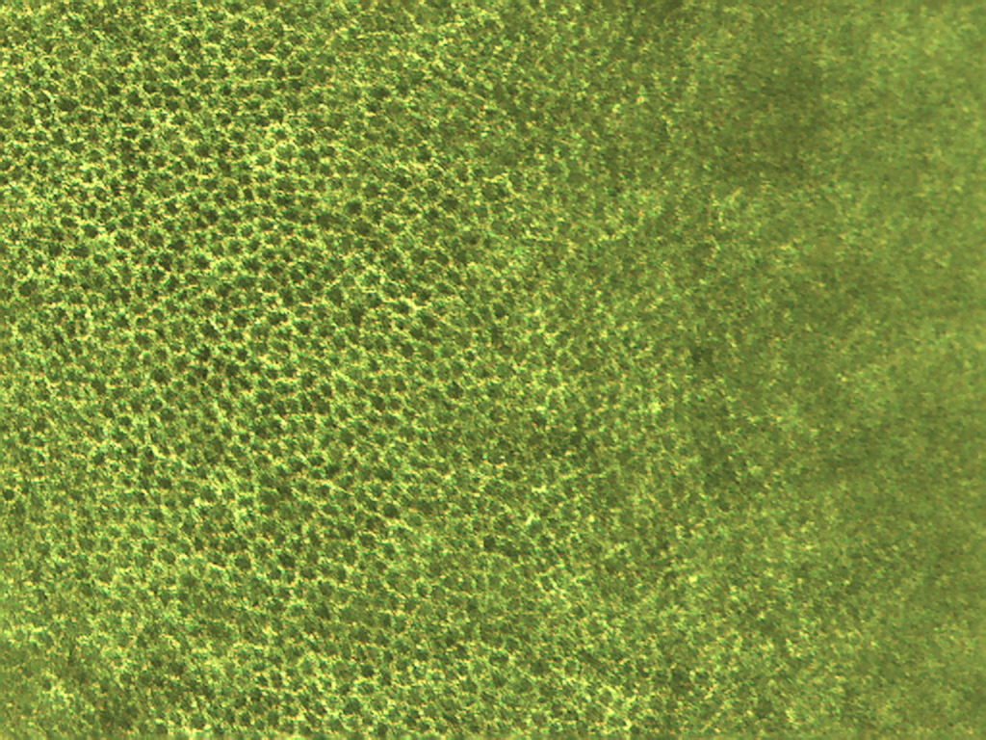
Notes:
273. Lens culinaris Medik. Lentil. Seed coat (testa), 25X

Slide 3
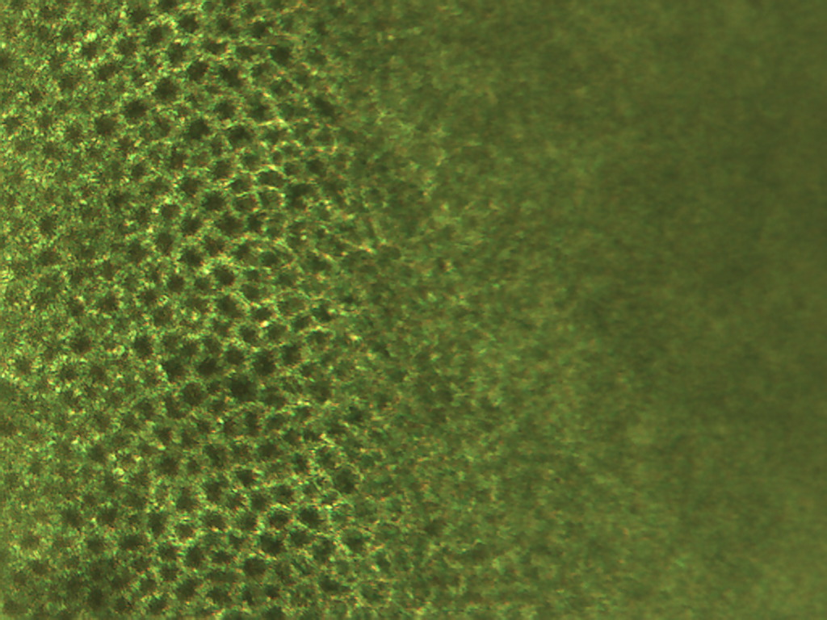
Notes:
274. Lentil. Seed coat (testa), 40X.

Slide 4
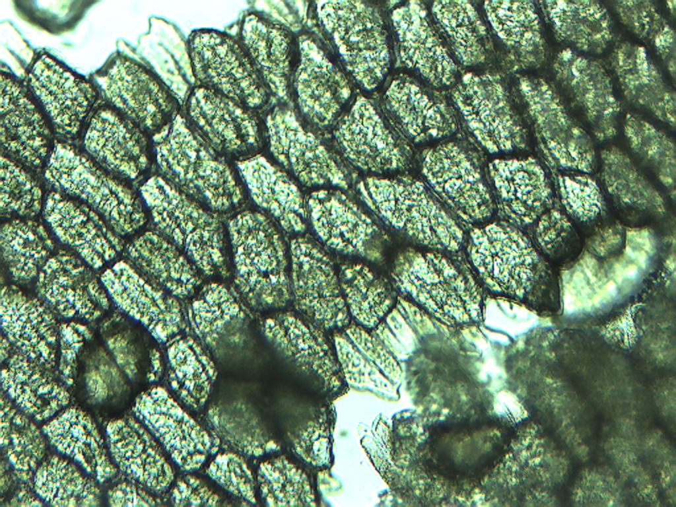
Notes:
275. Lentil. Pulp parenchymal cells, 10X.

Slide 5
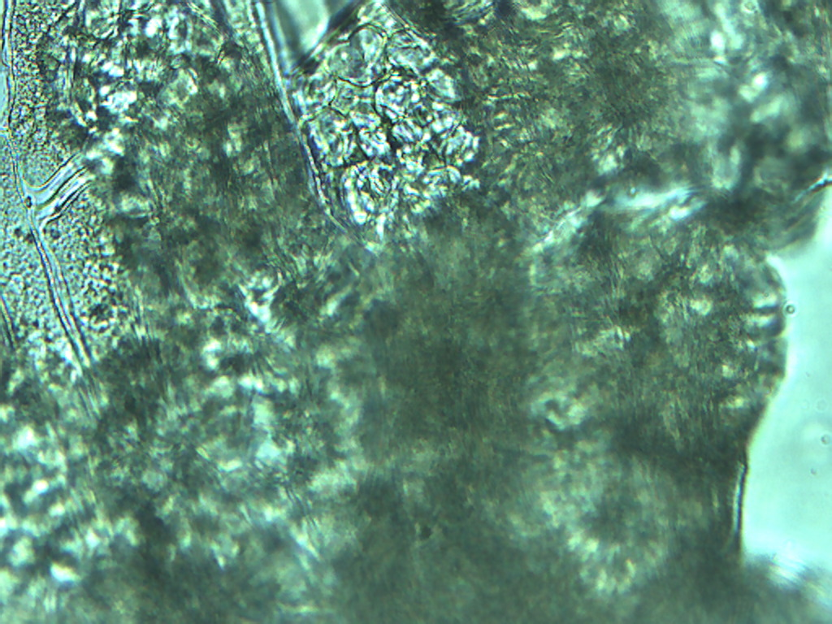
Notes:
276. Lentil. Parenchymal pulp cell in clump showing surface detail (arrow), 25X

Slide 6
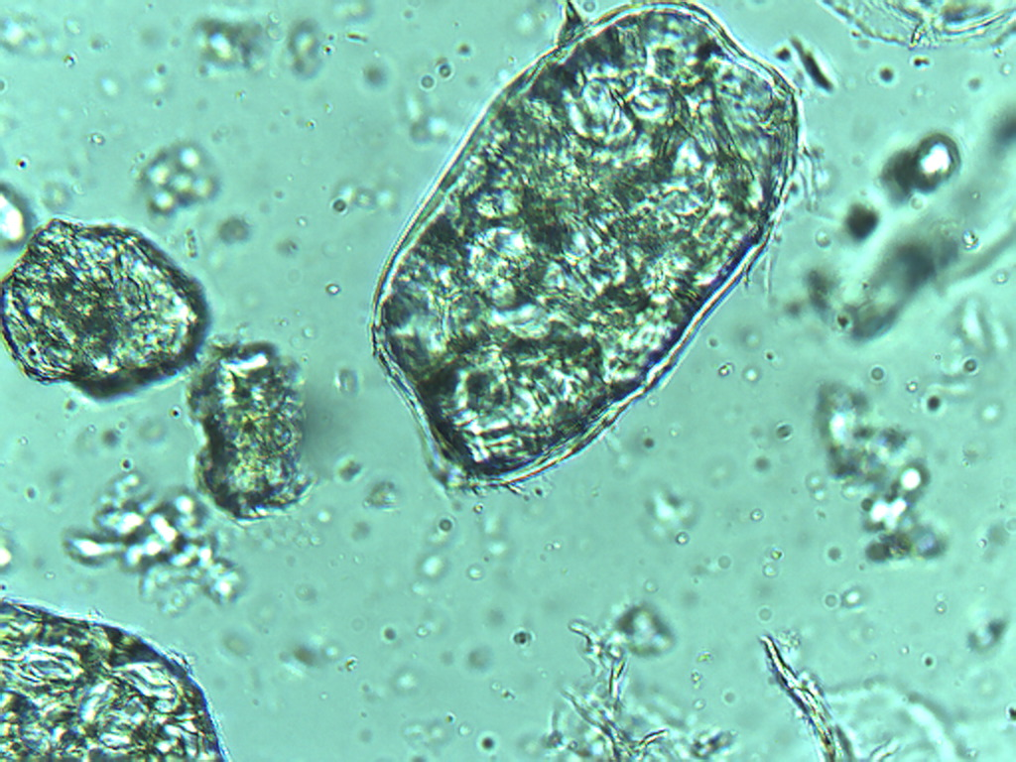
Notes:
277. Lentil. Free pulp parenchymal cell, 25X

